Slide 1
The Future of Education?

Slide 2
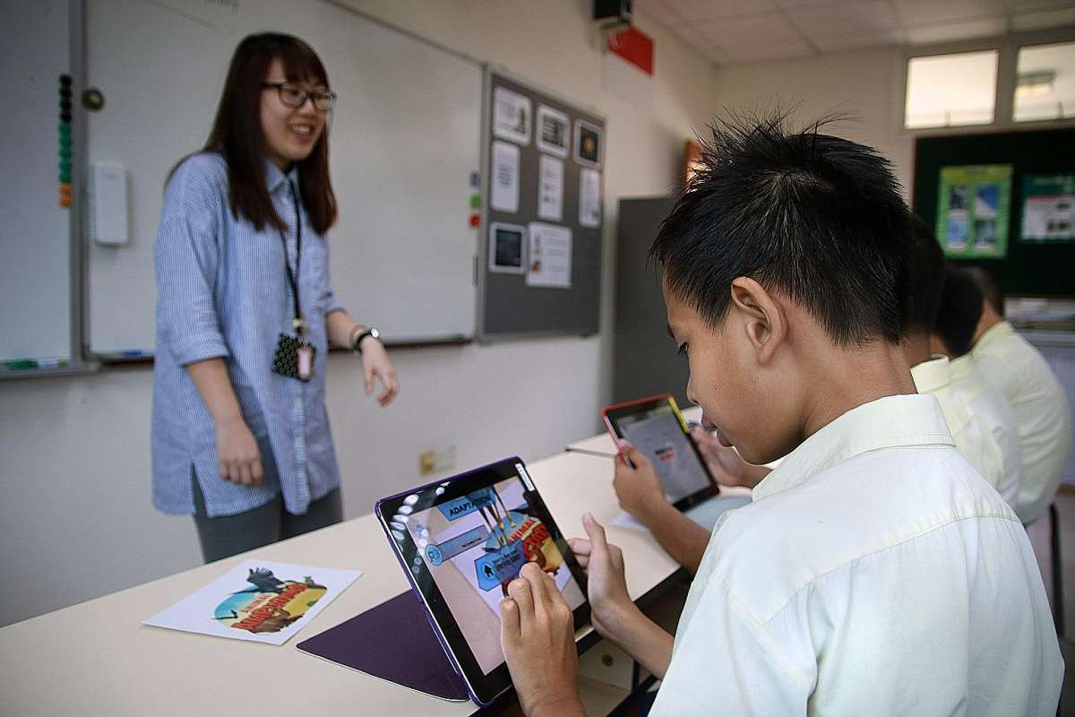
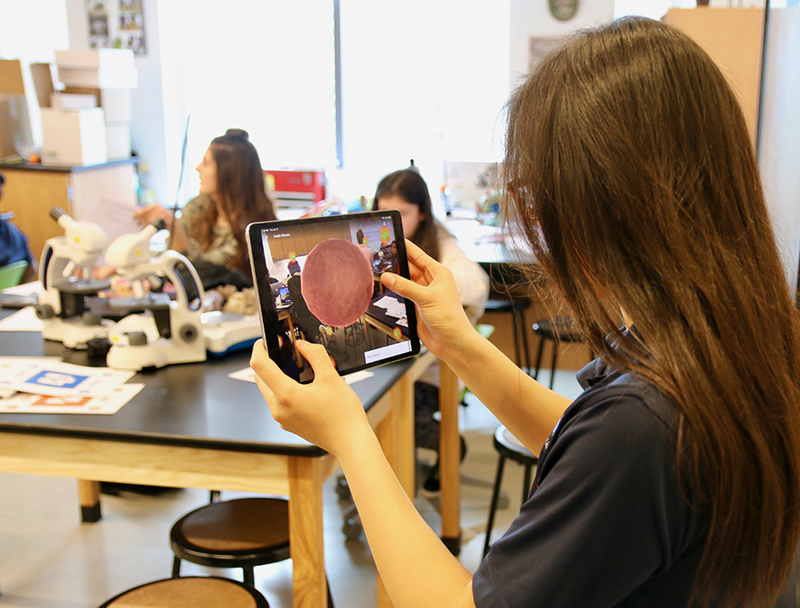
BENEFITS
Engagement & interest
Any level of education
Notes:
We’ll start off with the potential benefits of augmented reality in education.
It encourages engagement and raises interest in learning with its game-like and interactive nature.
It is also universally applicable to any level of education and training, from preschool to university and even on-the-job training and internships, it isn’t limited to only one use case or field of application.

Slide 3
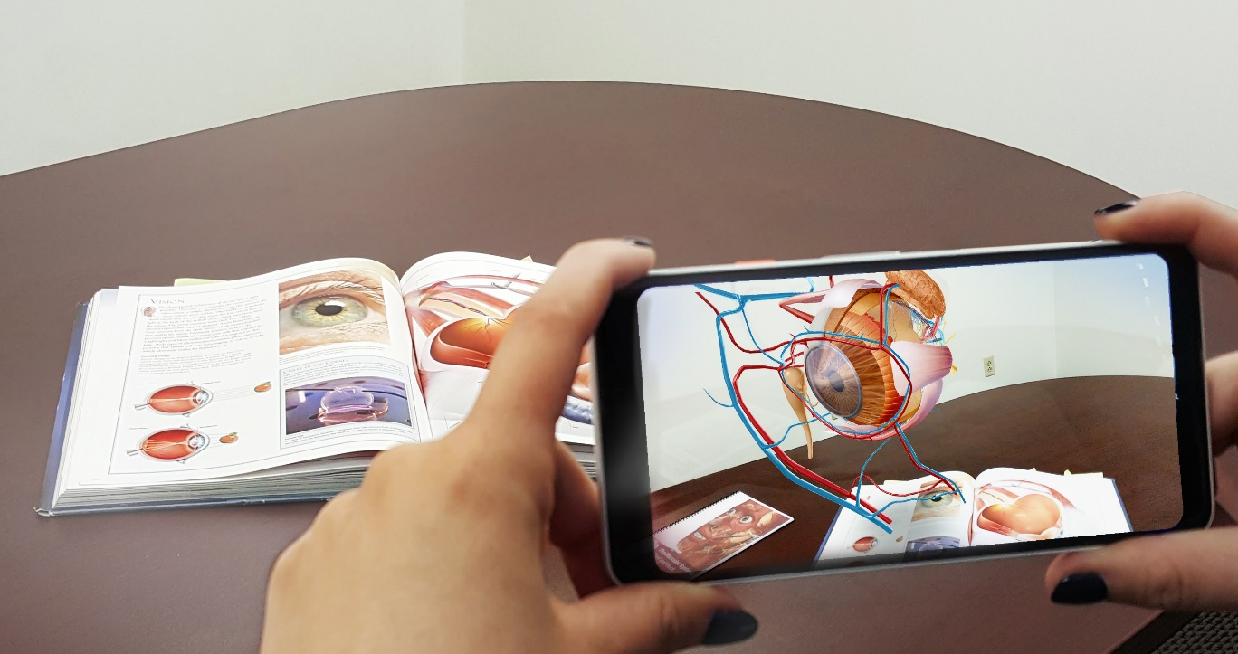
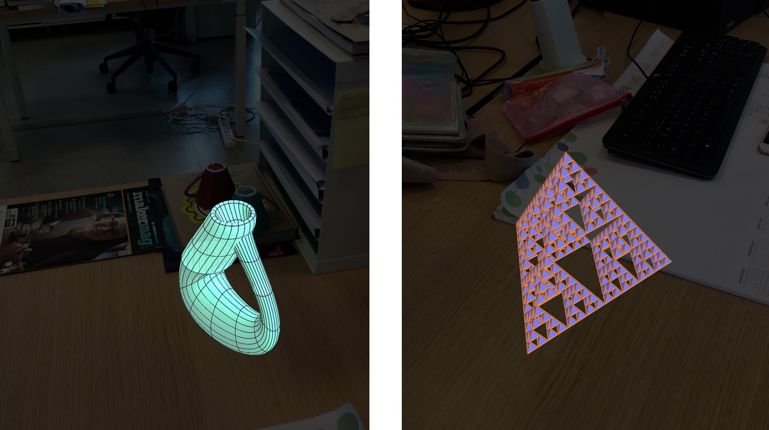
BENEFITS
Engagement & interest
Any level of education
Spatial concepts
Biology
Mathematics
Notes:
It can be used to make hard to grasp spatial concepts easier and more intuitive to understand, not being limited to displaying in only 2D.
Two examples of the use cases being in Med School or Biology classes, presenting organs, veins or nerves without the need of a human body, or presenting and analyzing geometric concepts in Maths such as surfaces or curves.

Slide 4
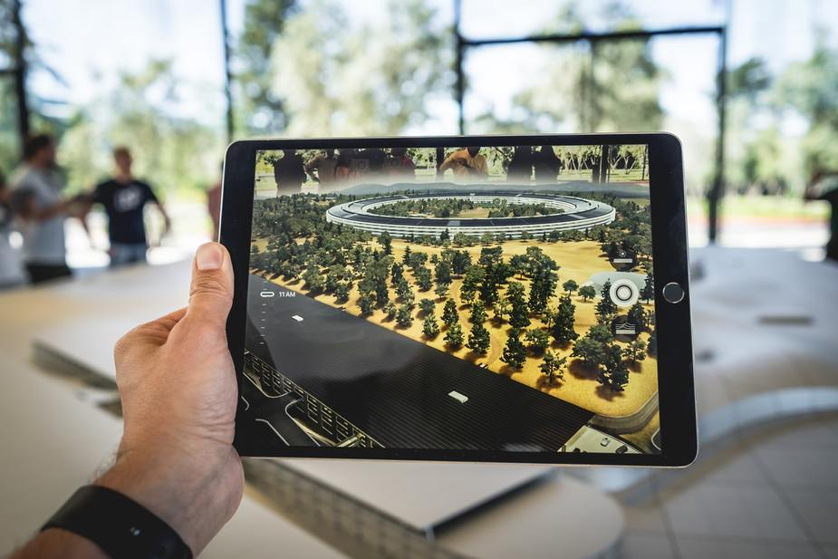
BENEFITS
Engagement & interest
Any level of education
Spatial concepts
Biology
Mathematics
3D designing
Creative
Designing parts
Architectural models
Notes:
AR can make designing in 3D much quicker, be it for creative purposes, for designing parts to be made later or for architectural models of buildings

Slide 5
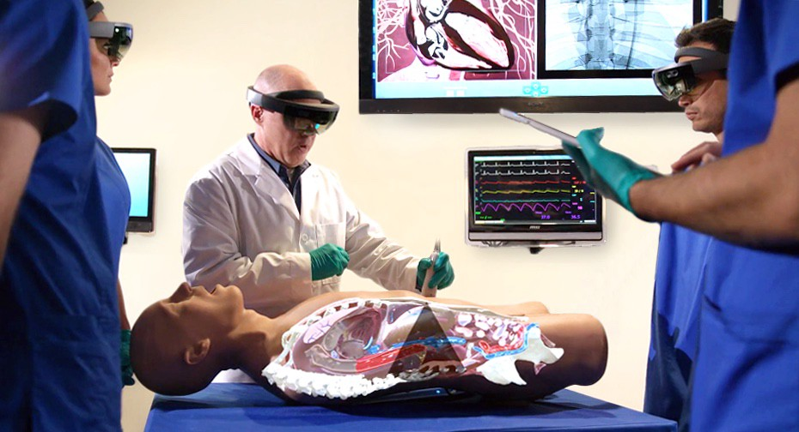
BENEFITS
Engagement & interest
Any level of education
Spatial concepts
Biology
Mathematics
3D designing
Creative
Designing parts
Architectural models
Safety
Notes:
Augmented reality also offers the possibility of safe training.
For example for feasibly dangerous chemistry experiments or practicing surgeries and other medical practices without putting people in danger or risking paying for damages in the case that something goes wrong.

Slide 6

ACCESSIBILITY
Relatively low cost
Smartphone
Internet
No special equipment required
Accessible learning materials
Portability
Notes:
Now comes the question of accessibility.
In terms of the price, access to augmented reality has a relatively low cost, since only a smartphone and a stable internet connection is needed, which now accounts for almost half of the global population.
There is also no need for special equipment. Unlike lab equipment that can be really expensive, everything in AR is driven either by the device or computed in a cloud. This also means that experiments that would take days can be sped up and presented in a normal time-frame.
Augmented reality has the potential to replace textbooks, physical models, manuals and learning materials and apps are rising each year.
One of the biggest factors that play into accessibility, even more nowadays with the current situation, and one of AR’s advantages is its portability making it virtually possible to use it anywhere, be it at school, work or at home.
All of this means that, globally, the transition to an AR driven education system and On-the-job training is quite possible in the next couple of decades.

Slide 7
Concerns
Harm & regulations

Slide 8
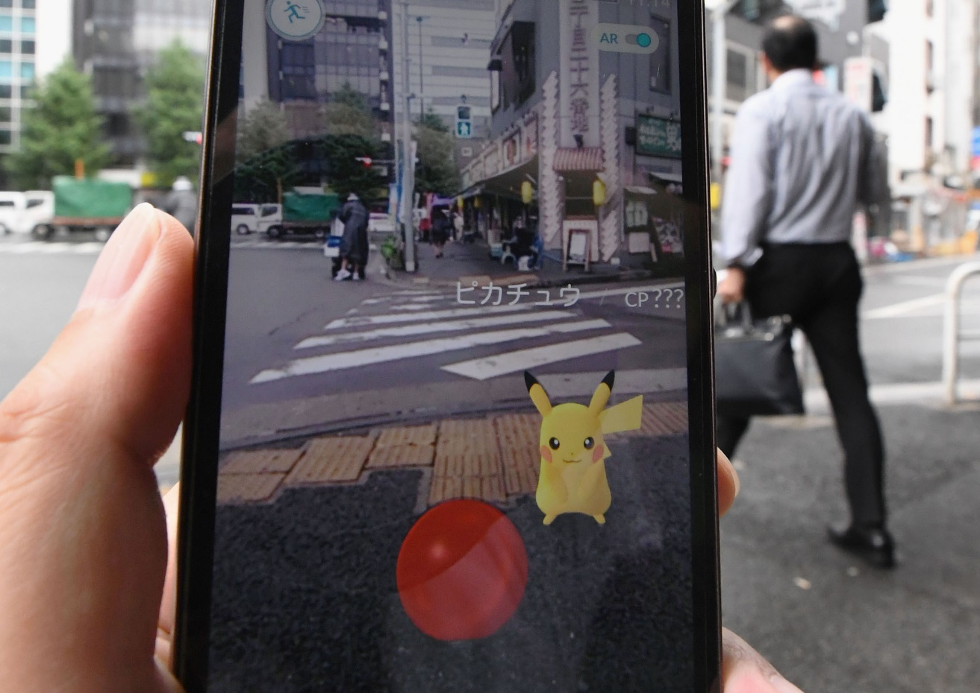
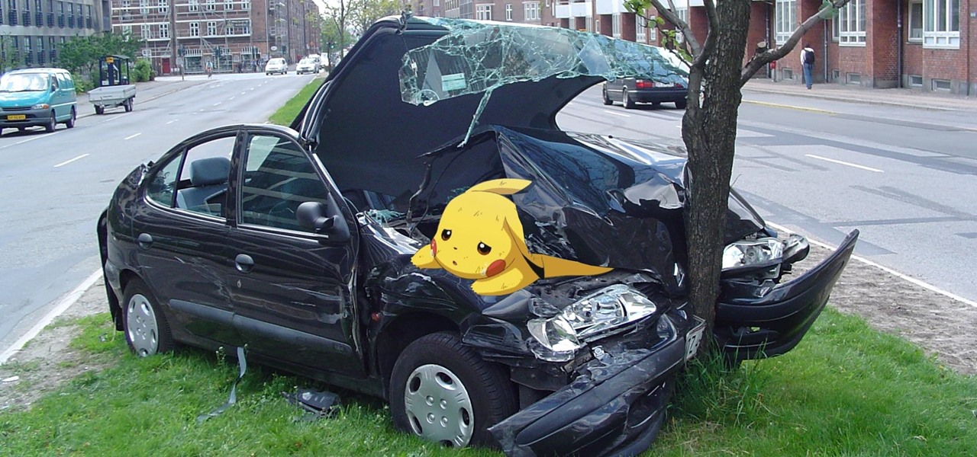
Physical Harm
POKEMON GO ACCIDENTS
Notes:
One major concern of augmented reality is physical harm caused by lack of attention.
One real-world example would be the Pokémon Go accidents, ranging from mild injuries to traffic accidents to kidnappings and in some cases death.

Slide 9
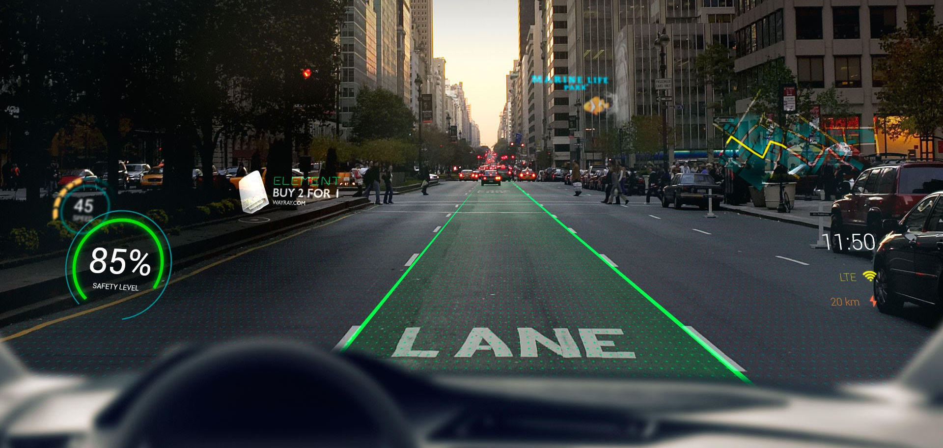
Physical Harm
Distractions
ACCIDENTS
Screen Clutter
Software Bugs
Notes:
Another concern comes up the automotive industry, where AR navigation will introduce a layer of details superimposed onto the real world.
Even though traffic accidents are bound to happen, they are more likely to be caused when the driver is distracted or overwhelmed with information or screen clutter in the form of ads or notifications.
Also, as over-reliance on AR navigation becomes more common, it can leave consumers vulnerable to buggy GPS overlays causing more issues to the driver.
This can be avoided though through regulation.

Slide 10

Regulations
Safety Risks
Privacy Concerns
Data Collection
Data Processing
Data Selling
GOOD
OR
BAD?
Notes:
Which brings me to my second concern, on the legal side of things, regulations or lack thereof.
Currently, there are no regulations to govern the usage of augmented reality.
Safety risks, like the ones I already mentioned are real, respectively could become a reality if not supervised.
There are also no regulations that help consumers understand which type of AR applications can be used and how they can collect, process and sell data. Hence, the technology can be used with malicious intent, raising privacy concerns.
While this can be good, AR is advancing rapidly in unpredictable ways and hopefully lawmakers will not push laws limiting AR’s development.

